Slide 1


Hii,
Iam Siddhika
Welcome to Power BI Series
Part -71

Slide 2



I’m very excited to dive into this with you all!
Are you ready to enhance your data visualization skills?
We focus only on the most used and important Visuals
Today Content
VISUALIZING DATA
MAP VISUALS MAP (BASIC) FILLED MAP

Slide 3

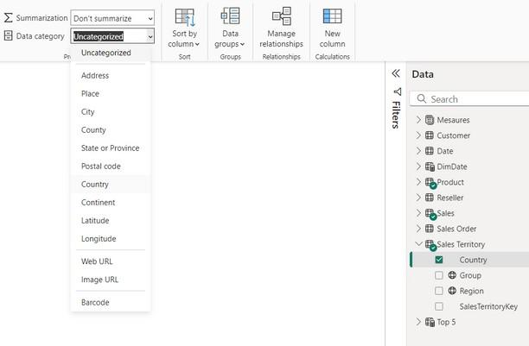

MAP VISUALS
We only see first 2 maps in our content
Map visuals in Power BI allow you to visualize geographic data on maps, making it easier to identify spatial patterns, trends, and insights. Power BI provides several types of map visuals, each suited for different types of geographic data analysis.
Types of Map Visuals
Map (Basic)
Filled Map
Shape Map
ArcGIS Maps for Power BI
first we need to categorize geographical columns by clicking on that column. Check this picture.

Slide 4
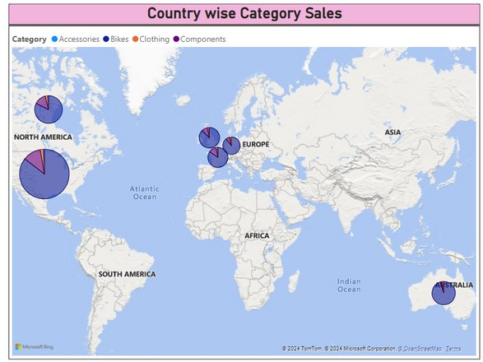


1.MAP (BASIC)
The basic map visual plots data points on a geographic map using latitude and longitude or location data (such as city or country names).
Try all the
formatting options
When to Use:
To plot individual data points on a map.
To visualize the distribution of data across different geographic locations.

Slide 5
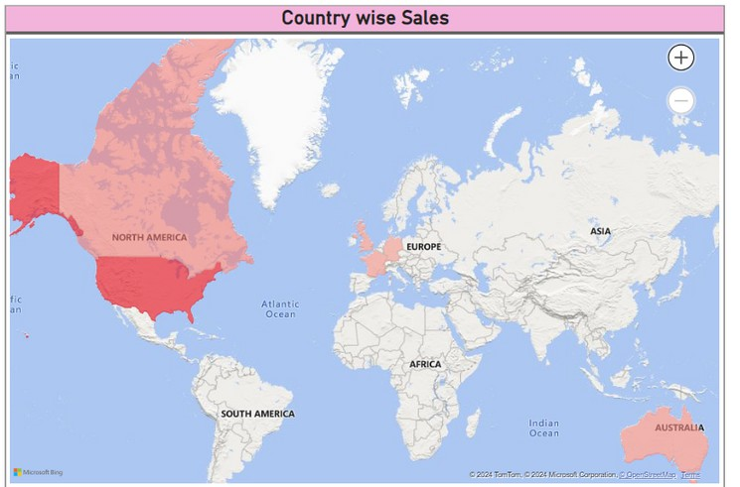

2. FILLED MAP
A filled map shades regions on a map based on the value of a selected measure, such as sales or population.
Try all the
formatting options
When to Use:
To show data distribution across regions.
To highlight areas with higher or lower values.

Slide 6


Thank you for joining me today to learn about Part -71 of Power BI!
Remember, Effective data visualization is crucial for turning data into meaningful insights and compelling narratives with Power BI.
Stay tuned for more insights and tips on Power BI in our next Series.
Follow

